Slide 1

http://csaladen.es/present

Slide 2


Slide 3

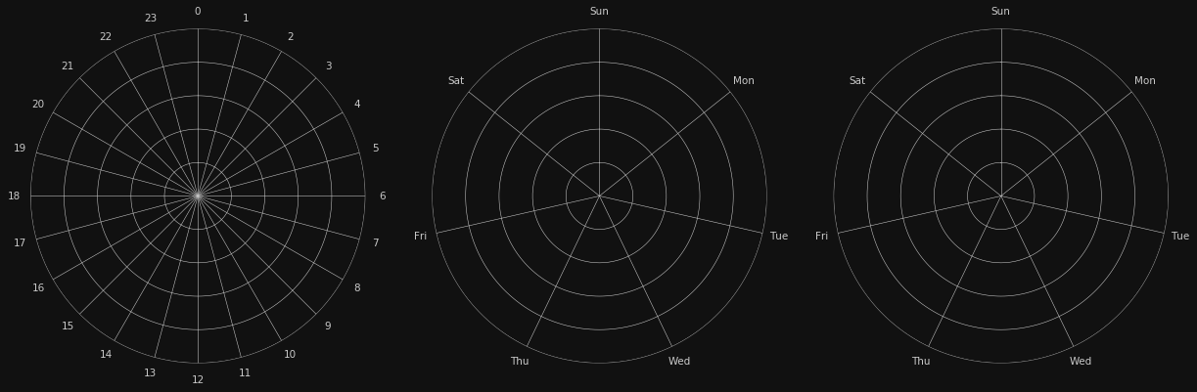
day
week
both

Slide 4
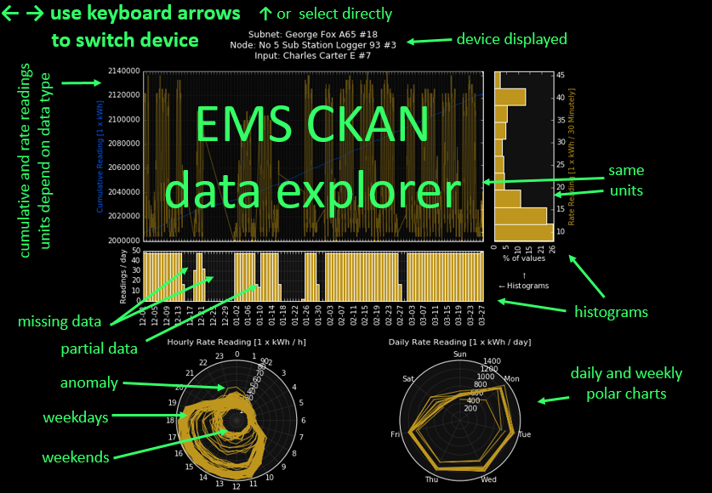

Slide 5
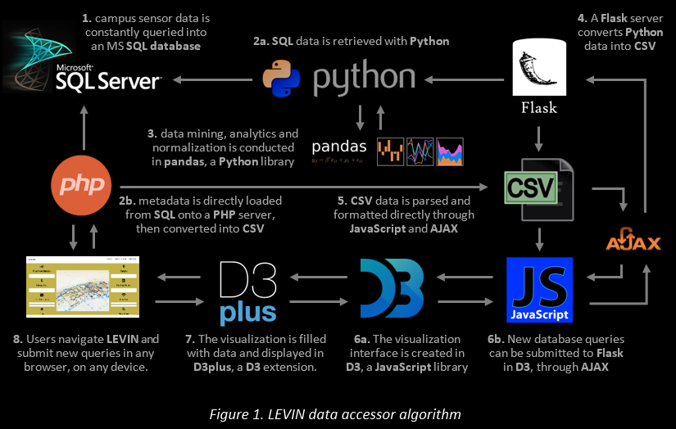

Slide 6
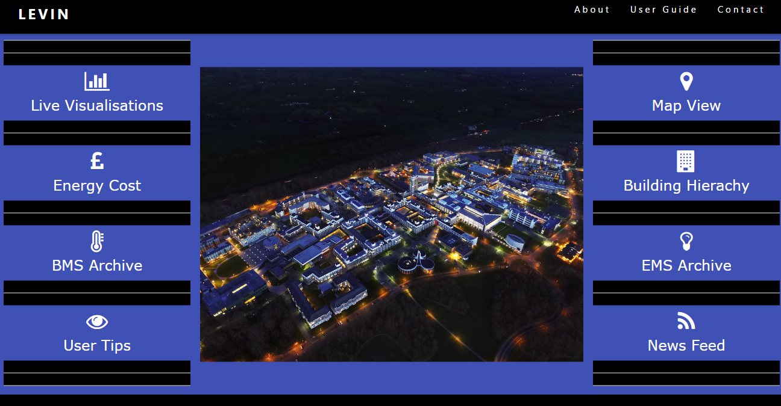

Slide 7

stories
Two peaks in residential building: early afternoon and evening

Slide 8
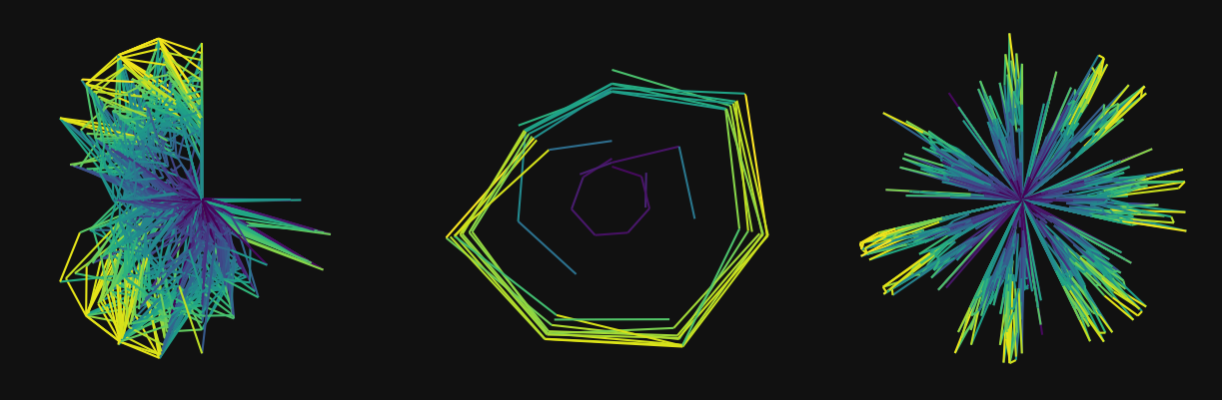
stories
Two peaks in residential building: early afternoon and evening

Slide 9

stories
Recurring afternoon gathering on Saturdays

Slide 10

stories
Tap left on overnight, turned off next morning at 6AM
Notes:
Water meter in bowland

Slide 11
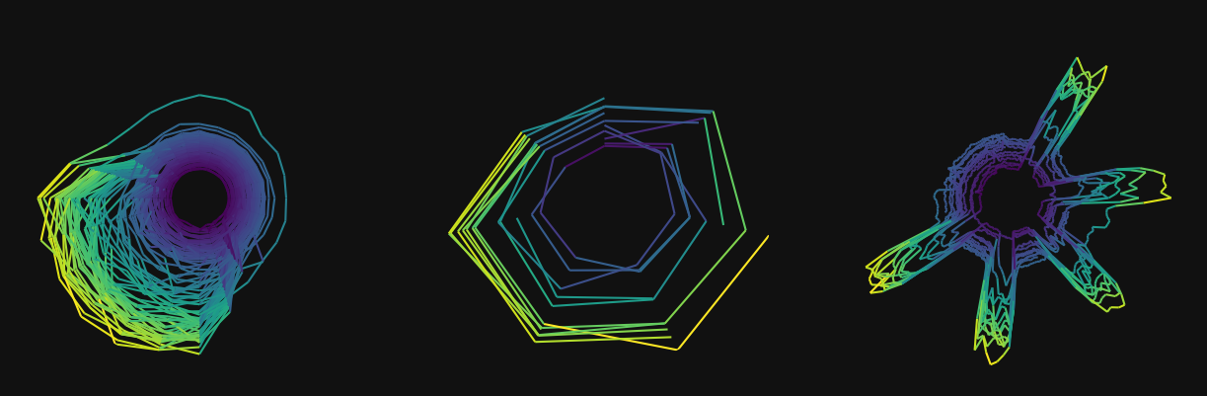
stories
Water leak throughout the night, fixed after two days
Notes:
Furness college 413 / overnight party

Slide 12
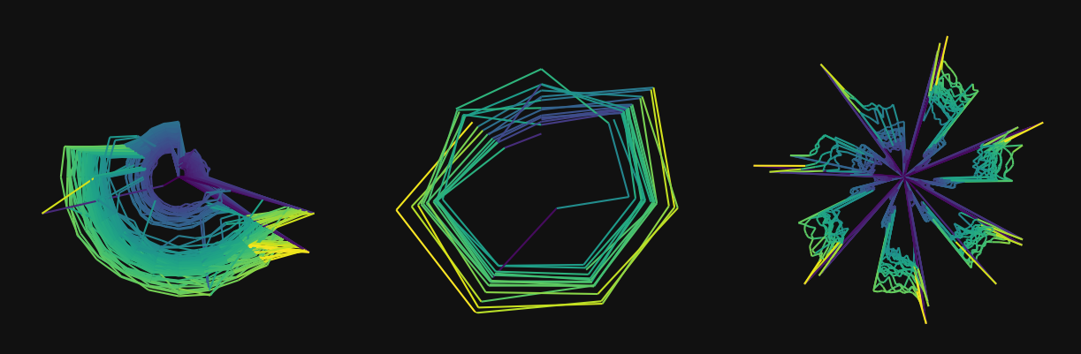
stories
Daylight-saving time kicks in
Notes:
257 George fox heat

Slide 13

stories
Tricky one: Easter holiday break + daylight-saving time
Notes:
ISS electricity

Slide 14
http://www.lancaster.ac.uk/energy-lancaster/
thank you

